Slide 1
.
ICAC 2024 Pre-Conference Workshop
TinyML in Action: Session 3
Tutorial 3 – TinyML for Plant Disease Identification
.
Mr. Asiri Lindamulage asiri.l@sliit.lk
Research Assistant
Department of Software Engineering
Sri Lanka Institute of Information Technology

Slide 2

Outline
On-device vs Oncloud inference
Conversion Flow for Mobile App Integration
Android implementation

Slide 3
On-device inference vs On-cloud inference
On cloud inference
Develop Tensorflow model
Develop a Flask, Django, FastApi server
Develop the mobile app to upload the image
Run the inference on a cloud server
Get the results back to the mobile app
Cons- Latencies, data usage, privacy issues
On device inference
Develop Tensorflow model
Convert to TfLite
Develop the mobile app to run inference
Display the results
Pros - Protects privacy, reduced latency, saves data usage, realt-time processing

Slide 4
Mobile Development Frameworks
Android (Java)
LiteRT (TFLite)
ExecuTorch (Pytorch Mobile)
Flutter
LiteRT (TFLite)
IOS (Swift)
LiteRT (TFLite)
ExecuTorch (Pytorch Mobile)
Still have to develop integration for IOS and Android seperately

Slide 5
Conversion Flow for Mobile App Integration
Design the model
Train the model
Optimize
Convert to TFLite
Tensorflow based keras model (model.keras)
Model.tflite
Mobile App
.tflite file is used
Java
Python

Slide 6

Model Development
Dataset: “PlantVillage Dataset”
CNN architecture – MobileNetV2 architecture
Input – 224*224 RGB Image
Output- a value between 1 and 0
Optimizations
Mixed precision quantization
https://github.com/asirigawesha/TinyML_Workshop_ICAC_2024
https://colab.research.google.com/drive/1bR1FMca4nlLMLtoiTPf4nf1Ht43ETUiX?usp=sharing https://tinyurl.com/2danzrv5

Slide 7
What is Mixed Precision Training?
Mixed precision training involves using different numerical precisions (data types) for different parts of a neural network's computations. Specifically:
32-bit floating-point (FP32): Single-precision floating-point numbers. These are commonly used for high numerical precision but are slower and use more memory.
16-bit floating-point (FP16): Half-precision floating-point numbers. These are faster and use less memory but may introduce rounding errors in some cases.
Softmax Layers
Normalization Layers
Loss Functions
cannot be quantized

Slide 8
Compressd vs non-compressed model comparison
Metric | Input/Output Not Quantized (on GPU) | Only Image Quantized
Original Size | 35019.02 KB | 35019.02 KB
TFLite Size | 7062.18 KB | 7062.18 KB
Latency of Optimized Model | 0.0059 s/sample
Latency of Original Model | 0.2084 s/sample
Original Accuracy | 0.9914 | 0.7296
TFLite Accuracy | 0.9421 | 0.7400

Slide 9
Android implementation
CameraX library – To get live camera feed to the mobile app
TFLite – For the inference
Other additional libraries necessary
Keep the tflite file ready
Use Andorid studio’s TFLite Integration tool to add the tflite file to the app.
You can implement a code to run inference on,
A image selected from gallery
For a live camera feed
For a video selected from the gallery

Slide 10
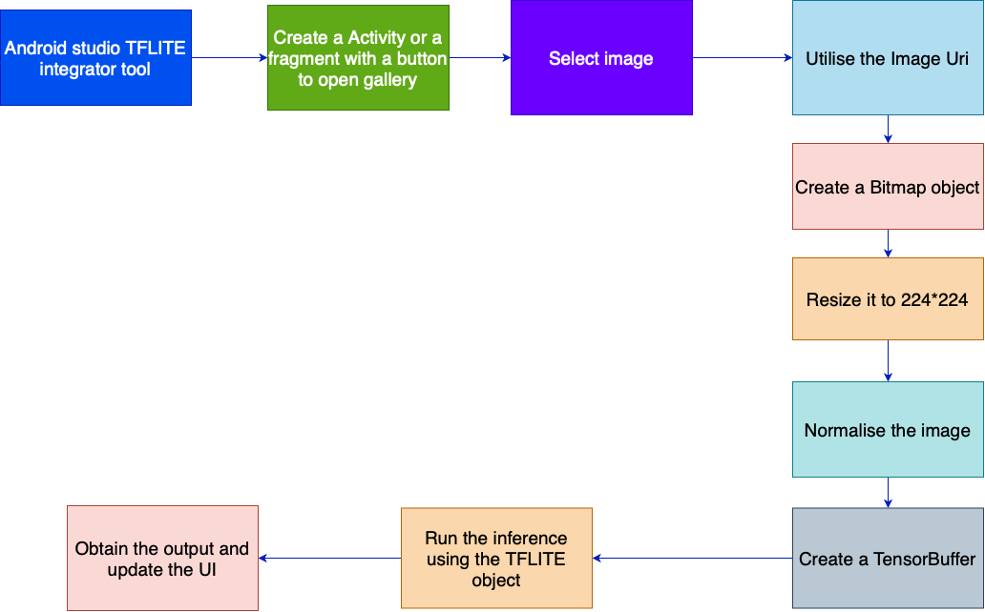
Android app inference on image from gallery

Slide 11
Android app inference on live camera feed
Instead of creating the bitmap from image. Create Bitmaps for each frame and follow the same procedure
CameraX is a latest API you can use to integrate camera activity to your code

Slide 12
Further Improvements
Use Threads for Model Inference: Always isolate machine learning model inference from the UI thread to ensure smooth user interactions and avoid UI freezing. Leverage asynchronous programming or background threads for inference tasks.
Optimize Input Image Size: Reduce the input image size during development, especially for the original, non-optimized model, to minimize computation requirements and speed up inference.
Implement Model Optimization Techniques: Experiment with various optimization techniques such as quantization (e.g., INT8 quantization), pruning, and knowledge distillation to compress the model and improve efficiency.
Choose Efficient Model Architectures: Use lightweight architectures like MobileNet, EfficientNet-Lite, or TinyML models that are specifically designed for mobile and edge devices.
Utilize Hardware Acceleration: Make use of device-specific hardware accelerators like GPUs, NPUs (Neural Processing Units), or DSPs (Digital Signal Processors) for faster inference using NNAPI, GPU, XNNPACK delegates .

Slide 13

Demo and Discussion
Discussion Question: How to improve the model performance?

